Slide 1
Asthma Risk Prediction Using Machine Learning
Under the Guidance of
Dr. R. Ravi Kumar
Department of Computer Science and Engineering

Slide 2
TEAM MEMBERS
2003A51090 - Manoj Kumar
2003A51081 - Gayathri
2003A51229 - Vineela Baisa
2003A51168 - Shiva Kiran
2003A51189 - Pramod

Slide 3
PROBLEM STATEMENT
The primary objective of this research is to develop robust predictive models using machine learning techniques to accurately assess the risk of asthma development or exacerbations in individuals.
Key challenges include:
Identifying relevant predictors and risk factors associated with asthma.
Dealing with the complexity and heterogeneity of asthma data, including genetic, environmental, and clinical factors.
Developing models that can effectively handle the temporal and dynamic nature of asthma symptoms and exacerbations.

Slide 4
OBJECTIVES
The objective of asthma risk prediction using machine learning is to develop accurate and reliable models that can effectively identify individuals at high risk of developing asthma before the onset of symptoms. By integrating diverse data sources, including clinical records, genetic information, environmental factors, and lifestyle variables, these models aim to uncover complex patterns and relationships that may contribute to asthma development. Ultimately, the goal is to enable early intervention strategies, personalized treatment approaches, and targeted preventive measures to reduce the burden of asthma on individuals and healthcare systems. Through the application of advanced computational techniques, such as machine learning algorithms, we strive to enhance our understanding of asthma pathogenesis and improve patient outcomes.

Slide 5
LITERATURE REVIEW
Title: Predicting Continuity of Asthma Care Using a Machine Learning Model
Description: This project utilized longitudinal electronic health records of asthma patients to predict future exacerbations. Logistic Regression and Decision Trees were employed to model patient data, considering factors such as medication history, demographics, and environmental exposures.
Algorithms Used: Logistic Regression, Decision Trees
Limitations: Limited generalizability due to single-center data, potential biases in electronic health record documentation, and challenges in capturing real-time environmental factors.

Slide 6
Title: Deep Learning for Asthma Prediction with Environmental Data Integration:
Description: This study integrated environmental data, such as air quality and pollen levels, with patient health records to predict asthma exacerbations. Convolutional Neural Networks (CNNs) and Long Short-Term Memory (LSTM) networks were used to capture spatial and temporal patterns in environmental data.
Algorithms Used: Convolutional Neural Networks, Long Short-Term Memory networks.
Title: Predicting asthma attacks in primary care: protocol for developing a machine learning based prediction model:
Description: This research leveraged data from wearable devices, such as smart inhalers and activity trackers, to predict asthma attacks. An ensemble of machine learning algorithms, including Random Forest, AdaBoost, and Gradient Boosting, was utilized to combine information from multiple sensors.
Algorithms Used: Random Forest, AdaBoost, Gradient Boosting.
.

Slide 7
Title: Asthma Prediction Using Transfer Learning and Electronic Health Records:
Description: This study applied transfer learning techniques to asthma prediction by leveraging pre-trained models on large-scale healthcare datasets. Transfer learning was employed to fine-tune deep learning architectures, such as pre-trained CNNs and LSTMs, on electronic health record data specific to asthma patients.
Algorithms Used: Transfer Learning, Convolutional Neural Networks, Long Short-Term Memory networks.
Title: Development of childhood asthma prediction models using machine learning:
Description: This Paper deals with the Identification of asthma at very early stages in which children fails to face. Machine learning approach is having better potentiality to experience better performance than any other existing models.
Algorithms Used: Regression based models.

Slide 8
Proposed Methodology
Utilizing Support Vector Machines (SVM) and Random Forest algorithms, our project predicts asthma occurrence and suggests medication, considering potential side effects. Integrated with a user-friendly Python GUI powered by TensorFlow within the VS code environment, our system ensures accessibility and usability for both individuals and healthcare professionals.

Slide 9
PROPOSED SYSTEM

Slide 10
DATASET
The dataset utilized in this project comprises individual-level records encompassing various parameters crucial for asthma prediction and management. These parameters include demographic information, environmental variables, behavioral attributes, and asthma severity scores. Each record encapsulates a unique combination of these variables, providing a comprehensive dataset for analysis and model training.
Additionally, a patient self-administered tool for assessing asthma control is incorporated. Scores range from 5 (indicating poor asthma control) to 25 (reflecting complete control), with higher scores suggesting better asthma management. An ACT score >19 signifies well-controlled asthma, with a test-retest reliability of 0.77. Other predictive tools such as the Asthma Control Questionnaire and Asthma Therapy Assessment Questionnaire are also acknowledged for their utility in asthma exacerbation prediction.

Slide 11
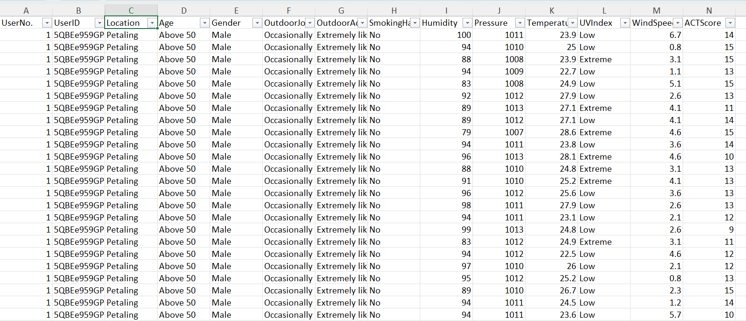

Slide 12
1.Age:
"Above50" mapped to 5
"41-50" mapped to 4
"19-30" mapped to 3
"31-40" mapped to 2
4.Outdoor Activities:
"Extremely likely" mapped to 1
"Neither likely nor unlikely" mapped to 2
"Not at all likely" mapped to 0
5.Smoking Habit:
"Yes" mapped to 1
"No" mapped to 0
6.UV Index:
"Low" mapped to 0
"Extreme" mapped to 1
2.Gender:
"Male" mapped to 1
"Female" mapped to 0
3.Outdoor Job:
"Rarely" mapped to 0
"Occasionally" mapped to 1
"Frequently" mapped to 2
This dataset, meticulously preprocessed, facilitates accurate asthma risk prediction using machine learning techniques, paving the way for enhanced patient care and management strategies.

Slide 13
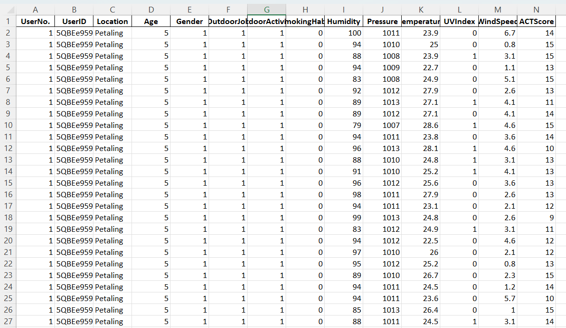
Fig: Data set Image

Slide 14
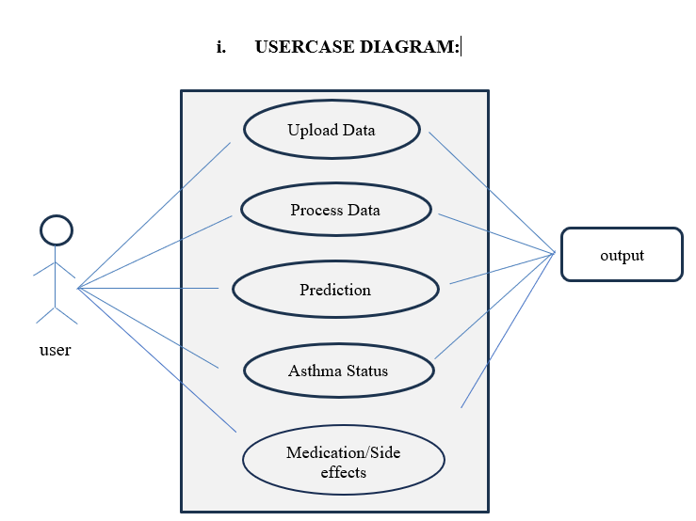

Slide 15
Actors:
User: Interacts with the system.
System: Represents the Asthma risk prediction System.
Use Cases:
Upload user data: User uploads the data for analysis.
View Diagnostic Results: User views the diagnostic data entered by user.
Prediction Results: Range of the asthma is identified along with medication.
Identify Range: System identifies and displays the required medication based on user input data.
Medication /Side effects: Resulted data helps the user to undergo the required traditional/Other medication.

Slide 16
Relationships:
User ->Upload User data: Association line connecting user and "Upload User data elements" use case.
User -> View Diagnostic Results: Association line connecting user and "View Diagnostic Results" use case.
User -> Prediction Results: Association line connecting user and "Prediction use case.
System -> Identify Range for asthma: Association line connecting the system and "Status" use case.
System -> Medication /Side effects: Association line connecting the system and " Medication /Side effects: "

Slide 17
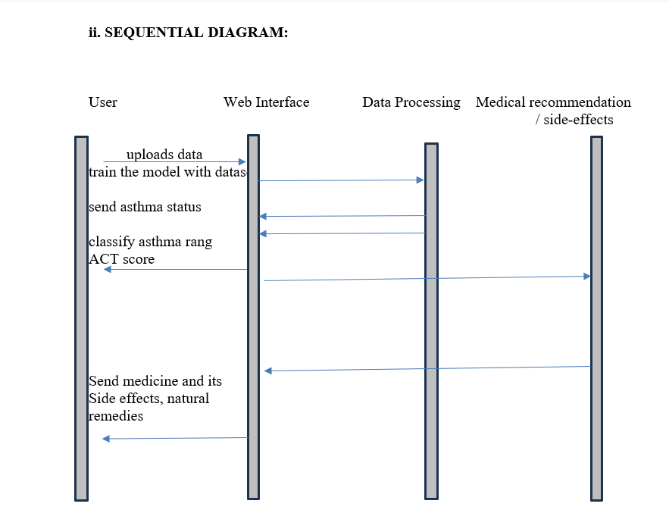

Slide 18
Results
The asthma risk prediction project utilizes SVM and Random Forest models to assess asthma likelihood based on user-input data. After input submission through the Python GUI, the data undergoes preprocessing, including encoding categorical variables. The models predict asthma control status, and the results, along with medication suggestions and potential side effects, are displayed on the web interface. Users receive clear indications of asthma prediction ranges, medication recommendations, and rare but serious side effects to enable informed decision-making about their health management. This streamlined process enhances asthma care by providing personalized insights and actionable recommendations.

Slide 19
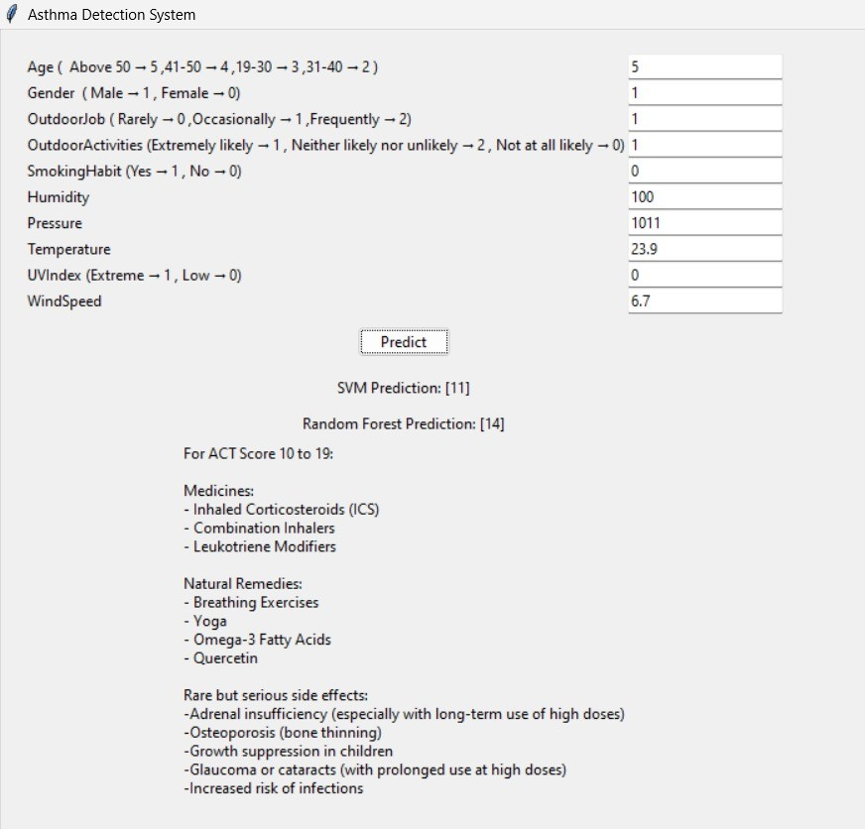

Slide 20
CONCLUSIONS
Asthma risk prediction using machine learning holds great potential for improving asthma management and reducing the burden of this chronic disease.
Addressing the challenges associated with data quality, feature selection, and model development is essential for the successful implementation of predictive models in clinical practice.
Further research and collaboration are needed to develop robust and generalizable predictive models that can effectively identify individuals at risk of asthma and guide personalized interventions and treatment strategies.

Slide 21
THANK YOU

